Slide 1
If your program does not work, try to run it using command prompt to see the error message

Slide 2
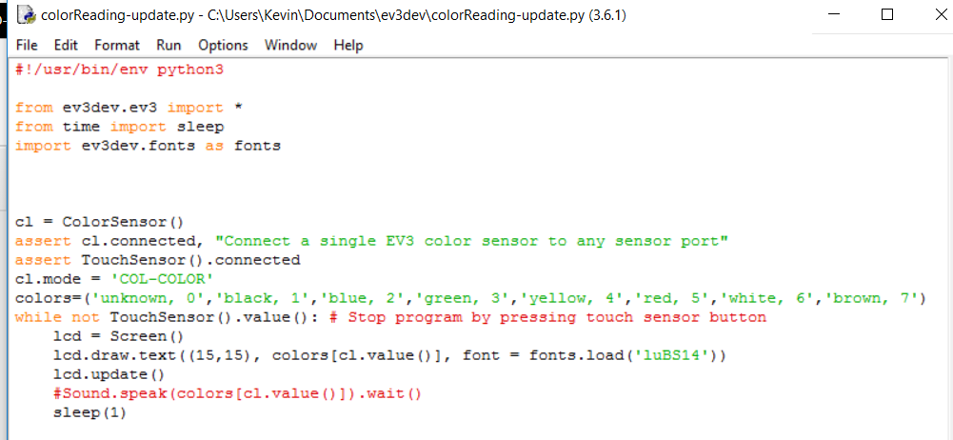

Slide 3
Exercise 1:
Step 1: Inside the tuple color, delete the numbers and commas only. Then use the Sound.speak function to speak the color state. Wait for 3 seconds before a new loop starts.
Step 2: Are the numbers indicating the colors from ev3dev similar to Mindstorms?

